Slide 1
PACKET SNIFFING & TRAFFIC ANALYSIS TOOL (HK-16)
TEAM NAME: NEXGUARD
TEAM MEMBERS:
SHAKTHIVEL RAJESH (LEADER)
SURYAA U
MOULLESH VARMA P

Slide 2
PROBLEM STATEMENT
Modern computer networks generate a huge amount of traffic every second. Identifying malicious activities such as unauthorized access, suspicious connections, or abnormal traffic patterns in this data is challenging.
Existing network analysis tools are often complex, resource-heavy, and require expert knowledge, making them unsuitable for students, small organizations, or quick security assessments. As a result, many potential threats go unnoticed until serious damage occurs.
There is a need for a lightweight, easy-to-understand, and efficient system that can monitor network traffic in real time and highlight potential security threats without relying on expensive or overly complicated tools.

Slide 3
PROPOSED SOLUTION
The proposed system is a real-time, security-focused network threat analysis tool that captures live network traffic or analyzes PCAP files and automatically identifies suspicious behavior.
The tool processes packets through protocol parsing and security feature extraction, followed by behavioral analysis to detect anomalies such as unusual port usage, repeated beaconing patterns, DNS tunneling attempts, and protocol violations.
Detected threats are converted into explainable alerts with severity scoring and supporting evidence, which are presented through a clear visualization and reporting dashboard. This enables faster threat identification and efficient security triage without requiring deep packet-level expertise.

Slide 4
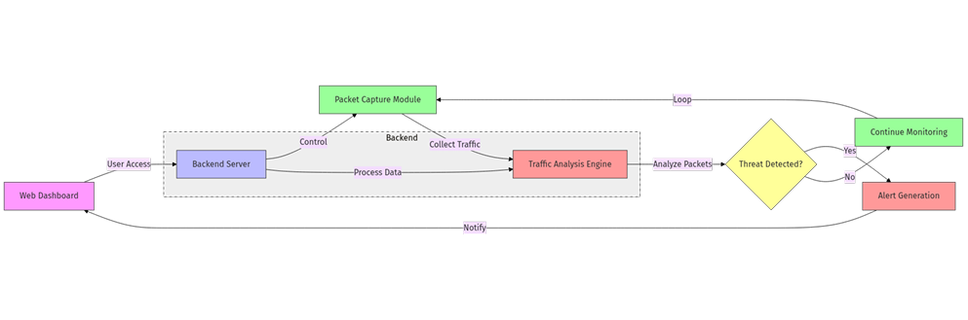
ARCHITECTURE DIAGRAM
This diagram shows the end-to-end architecture of the network threat analysis system, from traffic capture to alert generation.

Slide 5
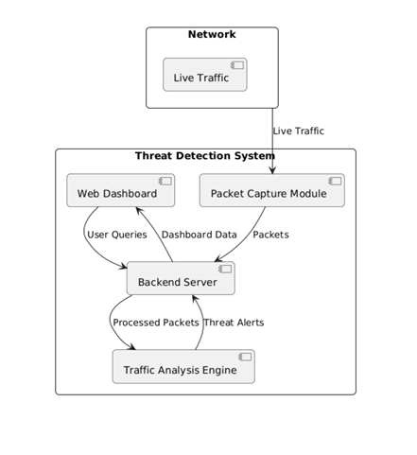
SYSTEM DESIGN
The workflow illustrates how packets are parsed, analyzed, and converted into security alerts.

Slide 6
PROTOTYPE WORKFLOW & IMPLEMENTATION PLAN
The prototype operates on PCAP-based network traffic for safe and repeatable testing.
Captured packets are parsed using Scapy to extract DNS-related fields.
Security features such as DNS query length and character entropy are calculated.
Extracted features are evaluated using rule-based detection logic.
When thresholds are exceeded, the system generates explainable security alerts.
If traffic remains within normal limits, no alert is raised, reducing false positives.

Slide 7
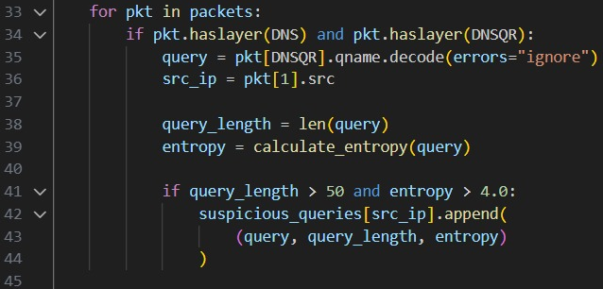
DETECTION LOGIC
• Detection Logic: DNS Tunneling
• Attack Concept:
• DNS tunneling hides malicious data inside DNS query names to bypass network defenses.
• Features Used:
• DNS query length
• Character entropy (randomness)
• Detection Rule:
• If DNS queries are unusually long and show high entropy, they are flagged as suspicious.
• Reasoning:
• Encoded or encrypted data increases randomness and query size compared to normal DNS requests.
• Output:
• Generates an alert with supporting evidence (query length and entropy values).

Slide 8
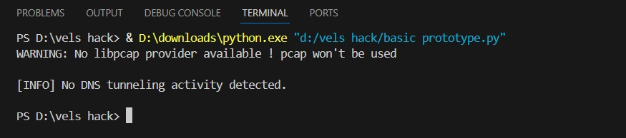
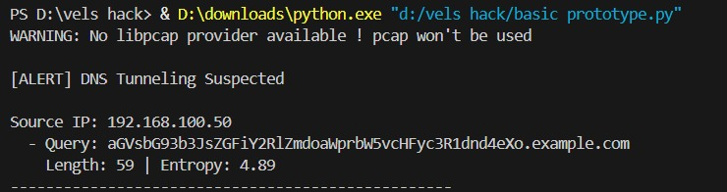
PROTOTYPE RESULTS
Normal DNS traffic produced no alerts
High-entropy DNS query triggered a tunneling alert

Slide 9
TOOLS/TECH STACK
Programming & Scripting
  Python 3 – Core language for packet analysis and detection logic
Packet Analysis & Networking
  Scapy – Reading PCAP files and parsing DNS packets
  PCAP files – Offline network traffic analysis for safe testing
Security & Detection
  Rule-based behavioral detection – Identifying anomalies such as DNS tunneling using entropy and query length
Development Environment
  Visual Studio Code (VS Code) – Code development and testing
  Windows OS – Development and execution environment
Output & Visualization
  Terminal / Console output – Displaying explainable security alerts
  (Future extension: Web dashboard / visualization layer)

Slide 10
LIMITATIONS AND FUTURE SCOPE
Limitations
  Detects only known attack patterns
  Scalability limits for high-speed networks
  Cannot inspect encrypted traffic
  Possibility of false alerts
  Depends on system resources
Future Scope
  AI/ML-based detection for zero-day attacks
  Real-time high-volume traffic analysis
  Encrypted traffic behavior analysis
  Advanced dashboard & visualization
  Cloud, SIEM & SOC integration
  Automated incident response

Slide 11
CONCLUSION
  Successfully designed and implemented a security-focused network traffic analysis system.
  Demonstrated real-time packet capture, analysis, and threat detection.
  Automated identification of suspicious network behaviors such as anomalies and misuse.
  Provided clear and explainable alerts instead of raw packet data.
  Showed how the solution goes beyond traditional packet analyzers.
  Established a strong foundation for AI-driven and enterprise-grade network security solutions.

